Slide 1
OVT Member Training
October
Notes:
Jay

Slide 2
Welcome & Introduction Polls
Who is in the room today?
What excites you about being an OVT?
What is one thing you hope to learn today about being an OVT?
Notes:
Jay

Slide 3
1922 2137
www.menti.com
https://www.menti.com/734ufmz2ro

Slide 4
Today’s Outcomes
Understand KESA Role in Kansas Vision
Describe OVT Roles and Responsibilities
Demonstrate OVT Processes
Understand the OVT Report
Be able to find Resources
Notes:
Jay

Slide 5
Acronyms
ADT: Accreditation & Design Team
KESA: Kansas Education Systems Accreditation
OVT: Outside Visitation Team
AAC: Accreditation Advisory Council
ARC: Accreditation Review Council
BLT: Building Leadership Team
DLT: District Leadership Team
BSC: Building Site Council
DSC: District Site Council
Notes:
Jay

Slide 6
KESA and the Kansas Vision for Education
Kansas Leads the World in the Success of Each Student
Notes:
Jay

Slide 7
Notes:
Jay

Slide 8
Notes:
Jay

Slide 9
Academically prepared for postsecondary success
= Process (Lead Measure)
High School Graduation
Postsecondary
Success
= Results (Lag Measure)
Notes:
Jay
As an OVT how can you help systems connect these outcomes? How can you help them build connections across their work?

Slide 10
Breakout Discussion (5 Minutes)
What personal experiences do you have with the State Board Outcomes that could be helpful in your work as an OVT?
As an OVT, how can you help systems make connections across the State Board Outcomes and the Definition of a Successful High School Graduate? How might you support systems in aligning/streamlining their work?

Slide 11
Accreditation Definitions
“Accredited” - Evidence of Process AND Growth (Results) / In Compliance
“Conditionally Accredited” - Insufficient Evidence of either Process OR Growth (Results) / In Compliance
“Not Accredited” - Insufficient Evidence of Process AND Growth (Results) OR Not in Compliance
Notes:
Jay
What do you think it means to be accredited in Kansas?

Slide 12
Focus Areas for Accreditation
Process (Foundational Structures & Qualitative State Board Outcomes)
Growth in Student Performance (Results, Quantitative State Board Outcomes)
Compliance
Notes:
Jay

Slide 13
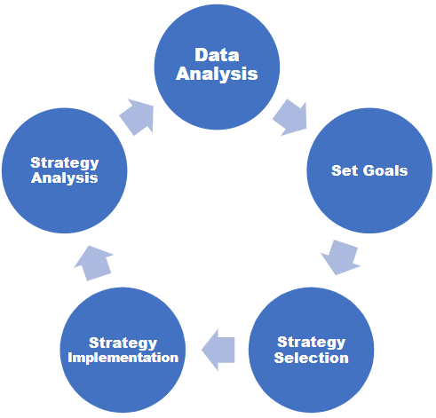
KESA Growth Cycle
KESA continuous improvement cycle for system improvement.
Notes:
Jay

Slide 14
Qualitative Measures
Notes:
Myron

Slide 15
Social-Emotional Growth
Students lacking nonacademic skills find postsecondary success more difficult
Process of acquiring nonacademic skills
Schools incorporating social-emotional and character development have increased student engagement and academic skills and decreased suspensions
Notes:
Myron

Slide 16
Kindergarten Readiness
Connection between early years and later success
Early learning programs make a difference
Parents/families make a difference
Notes:
Myron

Slide 17
Individual Plan of Study
Required from 8th through 12th grades
Process and product
Helps students plan for success after high school
Notes:
Myron

Slide 18
Civic Engagement
Civic and Social Engagement is embedded in the pre-K-12 curricula.
Students provided opportunities to practice responsible decision-making and informed social awareness.
Understanding of key governmental processes and documents.
Notes:
Myron

Slide 19
Quantitative Measures
Notes:
Sarah

Slide 20
Academically Prepared for Postsecondary
The percentage of students scoring at levels 3 and 4 on the Kansas State Assessment in Math, ELA and Science
Growth is demonstrated longitudinally
Data is disaggregated by all relevant subgroups of >10
Notes:
Sarah
OVT helps the system review data from all perspectives (grade level, student level, cohort, etc.)

Slide 21
High School Graduation
No high school diploma = Almost no chance of achieving middle class
Only 17 percent of all jobs available to those with no high school diploma
Available jobs may not provide a living wage or health care benefits
2020- 2021 Kansas graduation rate = 88.1 percent.
Notes:
John

Slide 22
Postsecondary Success
In 2020, education demand for jobs in Kansas: 29 percent high school diploma or less; 35 percent associate’s degree; 25 percent bachelor’s degree; 11 percent master’s degree
State goal: 70-75 percent
Two pieces of paper
Notes:
Sarah

Slide 23
OVT Roles and Responsibilities
Notes:
Myron

Slide 24
An OVT is…
the group of education professionals charged with coaching, mentoring and supporting a district/system for the duration of the system’s accreditation cycle.
Notes:
Myron
•Group size will vary, depending on the size and need of the system

Slide 25
Word Cloud
When you think about the traits/attributes of a good coach and/or mentor, what comes to mind?
Notes:
Myron

Slide 26
OVT Purpose
Conduct system visits
Build positive, supportive relationships
Provoke thought
Question and actively listen
Coach, mentor, guide
Create the OVT Annual Report to:
Provide feedback to system on progress
Provide documentation to the ARC for accreditation determination in year-5
Notes:
Myron
Build positive relationship - between the District Leadership and the District Leadership Team (DLT)
Provoke Thought - push for progress, challenge thinking through the accreditation cycle, ask the hard questions

Slide 27
OVT Member Requirements:
Complete required training
System yearly on-site visits
No conflicts of interest
Impartial and professional
Notes:
Myron
This training serves as the required training.
Conflict of Interest: The individual or a member of their household may not have a familial or financial tie to the district or any school within the district for which they are serving as a team member. It is highly recommended that members of one system should NOT serve on the OVT (as a member or Chair) for a system whose employees are on their OVT – avoid reciprocity when possible.

Slide 28
OVT Responsibilities
Five-year commitment
Attend yearly on-site visits
Prepare thoroughly and participate actively
Review all materials provided before visit(s)
Provide support to system as needed
Notes:
Myron

Slide 29
OVT Member Role
Support and communicate with OVT chair
Collaborate with other OVT members
Assist with annual summary report as assigned by chair
Notes:
Myron

Slide 30
OVT Chair Role and Responsibilities
Coordinate all work/visits with systems
Facilitate support for system in the growth process
Leads team members and ensures they have needed resources
Submit OVT annual report using the authenticated application
Make sure that the System & OVT contact information is up to date (work with your system contacts to ensure this on both sides)
Notes:
Myron
Visit with team members about report ahead of time

Slide 31
OVT Chair Role and Responsibilities
Obtains and shares the system annual report with OVT
Provides leadership in the completion of all chair annual summary reports within 30 days of the onsite visit, and assigns OVT member responsibilities
Notes:
Myron

Slide 32
OVT Process
Notes:
Sarah

Slide 33
Break-Out Discussion (5 Min)
Based on your roles and responsibilities, what do you think your team would need to do before, during, and after an OVT visit?
Notes:
Sarah
Explain we’re going to do a carousel or gallery walk with their answers. Need to collect information and add it to the papers on the wall.

Slide 34
OVT Before
Chair
Register in authenticated application
Initial system contact
Schedule visit (half or full day)
Identify changes of OVT members
Set agenda focuses on goals, progress and supports needed
Remind them that system yearly report needs to be in application 30 days before the visit.
Notes:
Sarah
When scheduling visit need to determine length, date, etc. Be sure to allow for time to write report on agenda setting.

Slide 35
OVT Before
All
Familiarize yourselves with the OVT Annual Report
Review System Report
Identify questions for visit
Identify possible focus groups
Identify questions for focus group interviews
Review systems Accountability Report
Decide main report responsibilities
Notes:
Sarah

Slide 36
OVT During
Chair
Pre Meeting with team members
Facilitates the visit
Post-meeting with OVT to discuss visit and write report
Notes:
Sarah

Slide 37
OVT During
All
Ask questions relevant to goals, action plan and System Yearly Update report
Ensure a working action plan is present
Review data to support findings in report
Facilitate stakeholder interviews
Take notes for the purpose of writing the OVT Annual Report
Notes:
Sarah

Slide 38
OVT After
Chair
Finalizes OVT Annual Summary Report
Submits OVT Annual Summary Report
No later than 30 days after visit
Notes:
Sarah

Slide 39
OVT After
All
Follows up on any system requests
Notes:
Sarah

Slide 40
OVT Process - Activity
Notes:
Jay

Slide 41
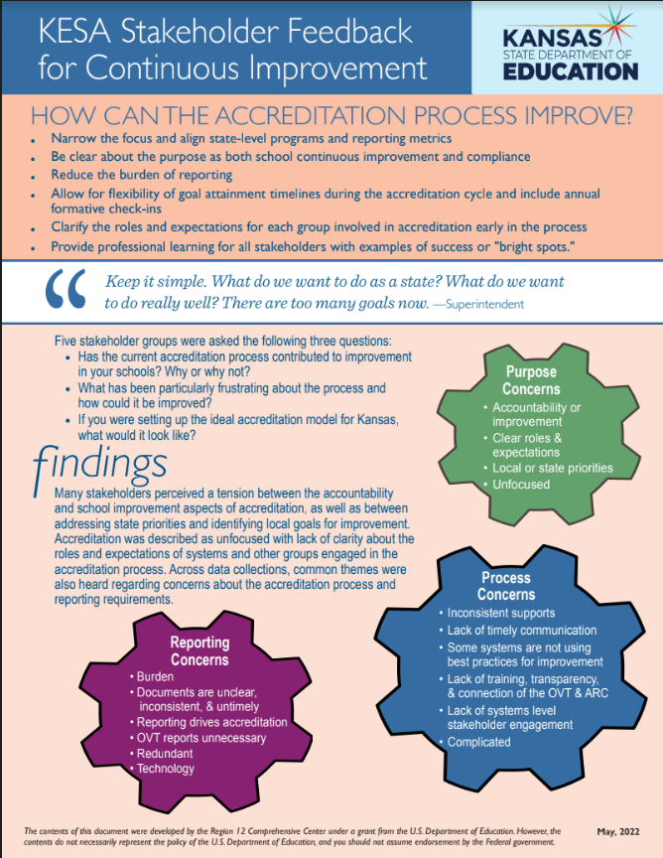
Focus Group Feedback
Superintendents
Curriculum Leaders
Accreditation Advisory Council
KESA Regional Training Pilot Systems
2023-
2024
2023-
2024
NOW
Notes:
Jay
STAMP (using ‘Annotate’) using the heart, star, or checkmark what resonates most for you on this feedback form.

Slide 42
Reporting Expectations - 2022/2023
Years 1-4
Year 5
Compliance
Needs Assessment Process & Goals
Assurances
Entire System Year 5 Report
Notes:
Jay

Slide 43
Resource - Questions for the Continuous Improvement Process
KESA Guidance Document
Phase Questions
Pages 30-31
Phase Rubric
Pages 44-48
Notes:
Jay

Slide 44
System Report Breakout - 20 Minutes
Discussion Questions-
What you do you notice?
What do you wonder?
What feedback do you have for the system?
What actions might you recommend to the system based on your review?
Process Questions-
Were any parts of the report confusing?
What was easy/difficult about this?
State Board Outcomes
Foundational Structures
Needs Assessment Process & Goals
Accountability Report
Notes:
Jay
Breakout = 20 Minutes
Debrief = 20 Minutes (5 min/room)

Slide 45
OVT Report
Notes:
Myron

Slide 46
Writing the Report
Purpose of Report
Results Based Evidence
Change as Evidenced by Data, Artifacts, and Narratives
Growth Terms
Notes:
Myron

Slide 47
What Makes a Good Report
System
OVT
Clarity in writing
Answers the question
Examples/evidence/data
Provides evidence of the system’s progress
Builds on learning and progress
Explains next steps
Writes for the OVT
Clarity in writing
Answers the question
Examples/evidence/data
Provides observations of the system’s progress
Highlights decisions, discussions and interviews
Provides support…Where to next
Summarizes visit
Writes to both system and Accreditation Review Council
Notes:
Myron

Slide 48
OVT Report - Activity
Notes:
Jay

Slide 49
OVT Report Breakout - 20 Minutes
Discussion Questions-
What you do you notice? Strengths?
What do you wonder? Opportunities?
What additional information might this report need?/How might this report be improved?
Process Questions-
How does this help you as you move forward as an OVT Chair?
What was easy/difficult about this?
State Board Outcomes
Foundational Structures
Needs Assessment Process & Goals
Notes:
Jay
Breakout = 20 Minutes
Debrief = 20 Minutes (5 min/room)

Slide 50
Resources
Notes:
Sarah

Slide 51
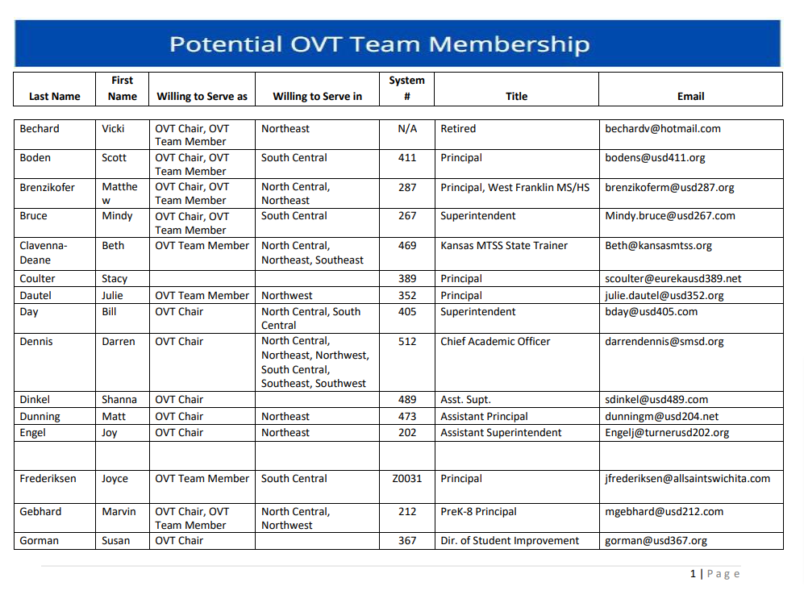
OVT Contact Sheet
Complete this google form so that you can be added to our contact list.
https://forms.gle/aYKFXqymakcfhmgB8
Link to the current contact list.

Slide 52
Role of KESA Guidance Document
Provides guidance and examples of the questions from the KESA Authenticated Application for:
System members
OVT chair
OVT members
ARC members
Notes:
Sarah

Slide 53
Additional Resources
KESA Homepage
Foundational Structures Rubrics
System/OVT/ARC summary documents/System Accountability Reports
Writing KESA Reports
Notes:
Sarah

Slide 54
Today’s Outcomes - Menti Poll
Understand KESA Role in Kansas Vision
Describe OVT Roles and Responsibilities
Demonstrate OVT Processes
Understand the OVT Report
Be able to find Resources
Notes:
Jay

Slide 55
accreditation@ksde.org
Notes:
Jay

